Slide 1
MIPS Simulator - SPIM
Lab1 – MIPS Programming

Slide 2
Outline
Introduction
Download & Install
How to use SPIM?
Debug
Demo

Slide 3
Introduction
SPIM是一種MIPS processor simulator, 其主要用來執行assembly language for MIPS.而此次作業希望同學能熟悉MIPS assembly language的implement並透過SPIM來simulate MIPS assembly language.

Slide 4
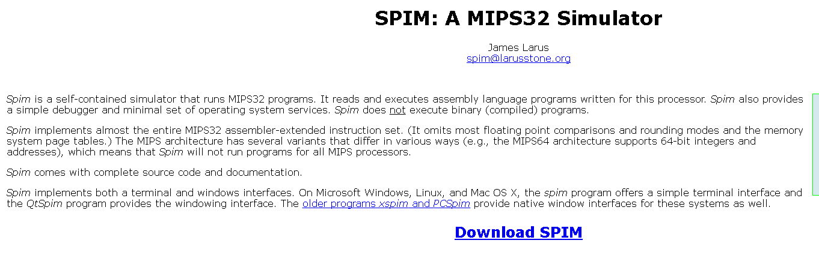
Download & Install
Download: http://spimsimulator.sourceforge.net/

Slide 5
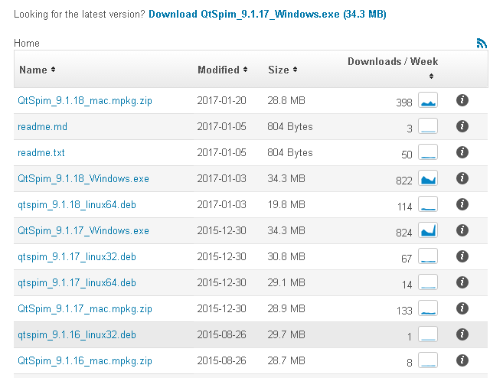
Download the version you want, then install it.

Slide 6
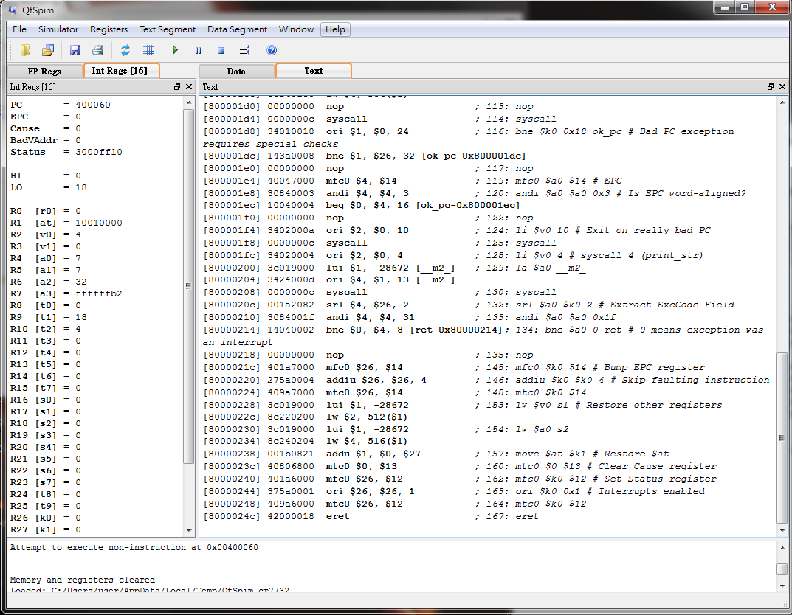
How to use SPIM?
2
1
3
4

Slide 7
1:顯示instruction的address
2:顯示data,例如：load進來的or stack裡的
3:MIPS中所有register的value($s1,$t1…..)
4:顯示一些資訊，例如error message

Slide 8
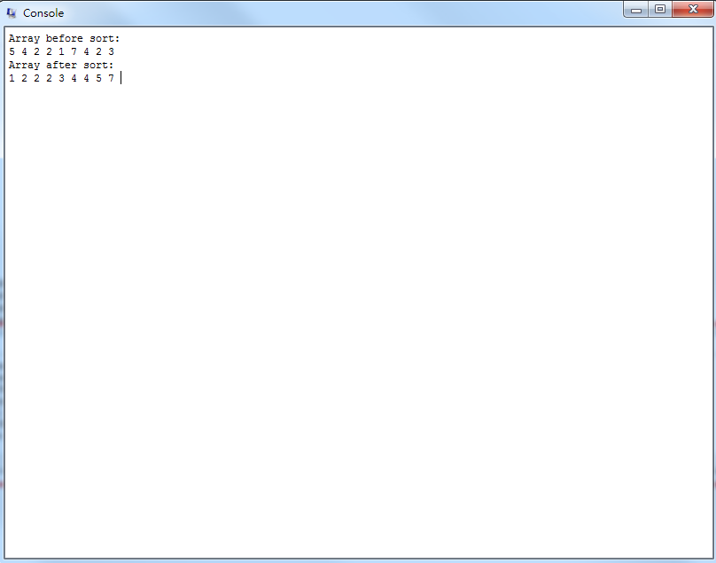
Console interface:
the interface (input/output) between program users and computer

Slide 9
Simple Steps
1. 新增一個.txt檔，並在上面撰寫MIPS code
2. 把附檔名改成.s
3. [File]->Reinitialize and Load File
4. [Simulator]->Clear Registers
5. [Simulator]->[Run]
有時候鍵盤右邊的數字鍵會讀不到數字，如果有同學遇到這個問題，請改用字母上方的數字鍵。

Slide 10
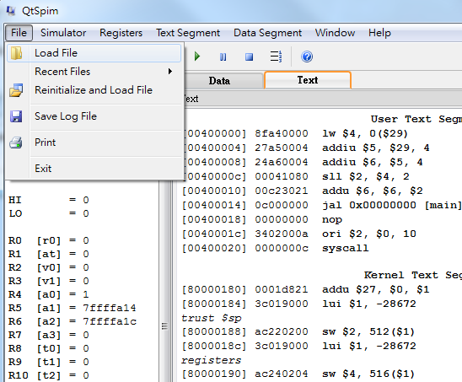
Load file “XXX.s”

Slide 11
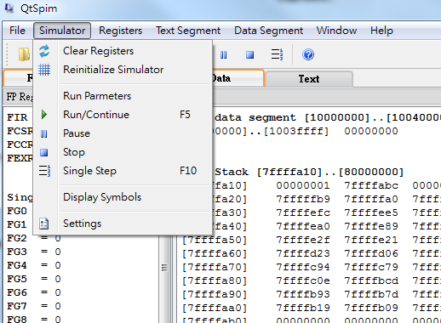
You have to clear registers if they were used in the previous program.

Slide 12
Run your program

Slide 13
Debugging
Two methods:
Simulator -> single step(F10)
Set breakpoints

Slide 14
Run a single instruction
For debugging

Slide 15
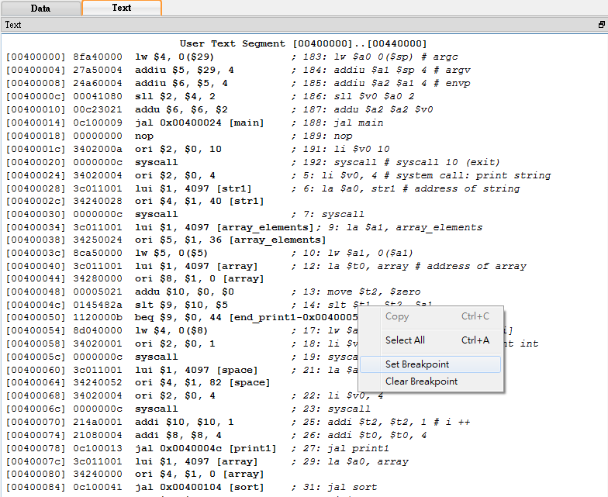
Click the right button
Set Breakpoints
Run your program, then it will stop at the breakpoints you set.

